Slide 1
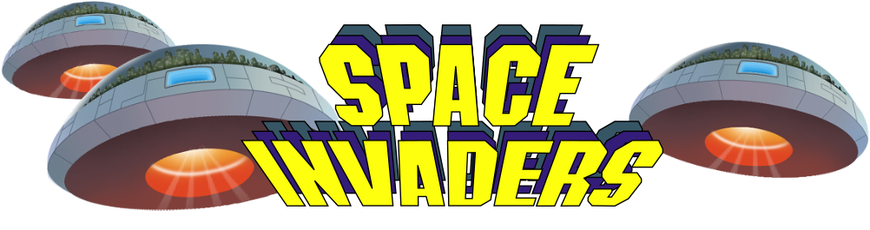
Shruti’s Space Invaders
SUBMITTED BY :
SHRUTI SNEHA DAS
E20BCA034

Slide 2
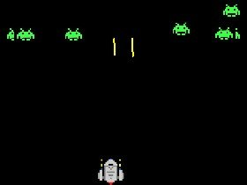
INTRODUCTION
Space Invaders is a 1978 arcade game which was created by Tomohiro Nishikado. It was manufactured and sold by Taito in Japan under the title of Uchu Shinryaku-sha and it was lincensed in the United States by the Midway division of Bally. Within the shooter genre, Space Invaders was the first fixed shooter and set the template for the shoot ‘em u genre. The goal is to defeat wave after wave of descending aliens with a horizontally moving laser to earn as many points as possible.
Figure 1: Screenshot of the original game.
Space Invaders is considered one of the most influential video games of all time. It helped expand the video game industry from a novelty to a global industry and ushered in the golden age of arcade video games. It was the inspiration for numerous video games and game designers across different genres, and has been ported and re-released in various forms.
Space Invaders is a fixed shooter in which the player controls a laser cannon by moving it horizontally across the bottom of the screen and firing at descending aliens. The player defeats an alien and earns points by shooting it with the laser cannon.
And if the alien touches the spaceship then the game is over.

Slide 3

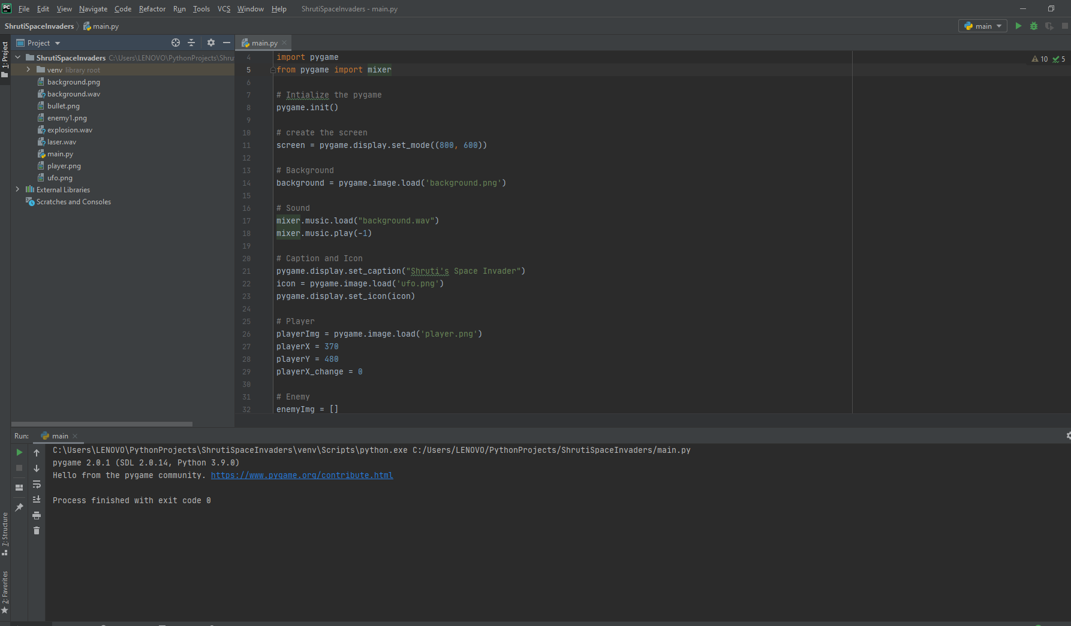
Environment
PyCharm is an integrated development environment(IDE) used in computer programming, specially for the Python language. PyCharm is a dedicated Python Integrated Development Environment (IDE) providing a wide range of essential tools for Python developers, tightly integrated to create a convenient environment for productive Python, web, and data science development. I have executed all the codes via this Pycharm.

Slide 4

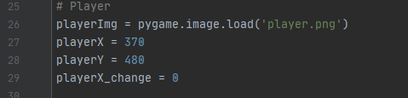
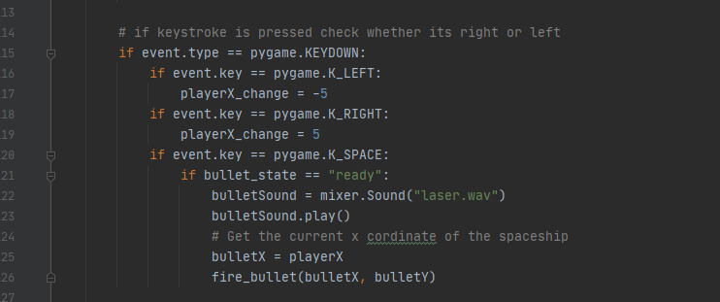
Player
Figure 1
Spaceship
Here in the figure 2,
The code is used for the player to order him some directions made by the user in the input. The player will act accordingly what the code has instructed and which direction it will move with the specific keystrokes.
Here in the figure 1,
The code is used for adding the player image to the screen. And the values are assigned to the player X and player Y so that the player that is the spaceship doesn’t go out of the boundary of the game screen.
Figure 2

Slide 5
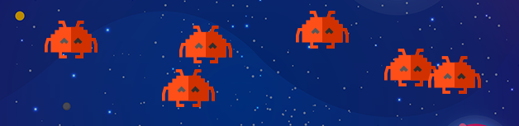
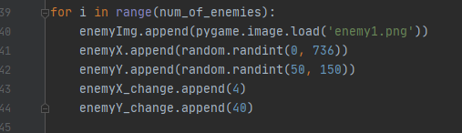
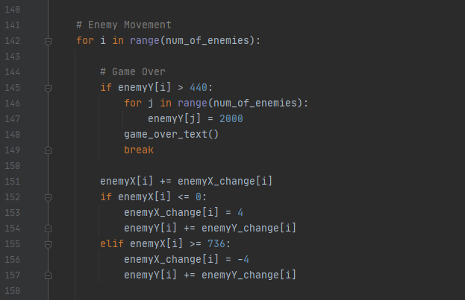
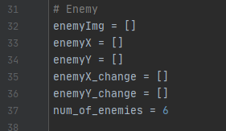
Enemy
This code helps in the movements of the enemies so that when the enemy reaches the end of one line it gets shifted automatically to the next line. With the speed of 4 and -4 for each of the enemies
This code helps in adding number of enemies to the game window by fixing a particular movement speed with respect to the screen resolution.
Number of enemies = 6

Slide 6

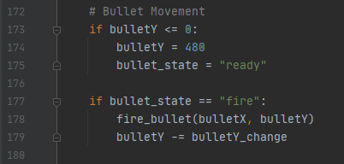
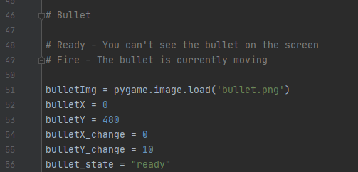
Bullet
The code adds the bullet image to the game window and sets the state of the bullet so that when the player will press spacebar keystroke then it will fire the bullet towards the enemy with the speed instructed. If the bullet state is not ready then the bullet will not appear on the screen neither it will move.

Slide 7
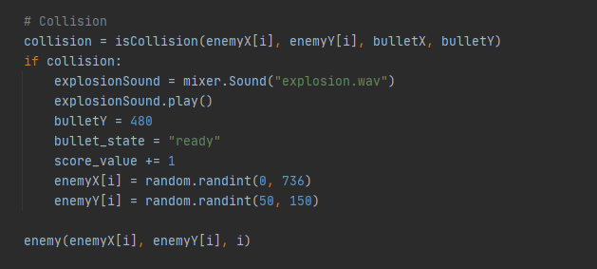
Collision
The above code explains how the collision between the enemy and the bullet will be made. The player uses Spacebar keystroke and fires a bullet to the opponent enemy so that the enemy jumps over the previous line back and the score will be +1. If the bullet doesn’t collide with the enemy then the player will not score a point.

Slide 8
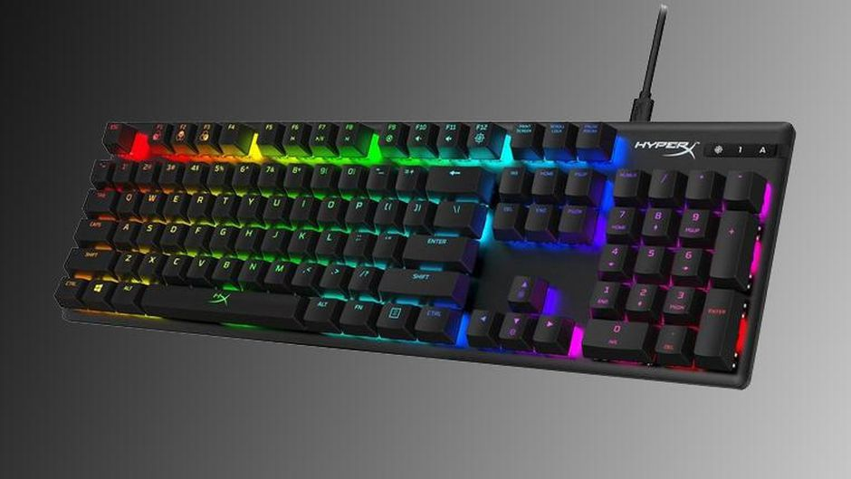
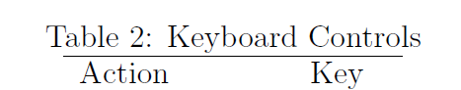
Operation Guide
The main objective in our implementation of the Space Invaders game is to eliminate all aliens in game. This implementation of Space Invaders has four levels of an ever increasing amount of aliens. The last level is then looped when completed so the player may compete for the high score.
The player has to fire its bullets in order to kill the aliens as they move ever closer to the player, simultaneously as the player has to evade their incoming shots. As the number of aliens begins to dwindle, they increase in speed and thus the difficulty. To the players assistance there are a couple of covers that can absorb the incoming shots.
But as the covers are hit, they systematically get damaged and ultimately destroyed. For each alien the player manages to kill, he will receive score. Sometimes, at random, a special boss alien will appear in the top of the screen and if the player manages to hit it the player will be awarded additional score.
In the table :
Left Key will move the spaceship to the left side, Right Key will move the spaceship to the right side while the spacebar is used for firing the bullets to the above aliens.
Left Left-key
Right Right-key
Shoot Spacebar

Slide 9
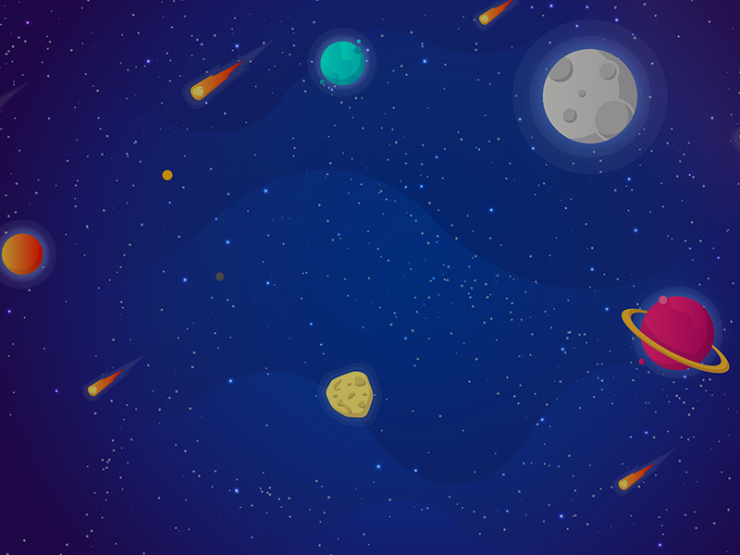
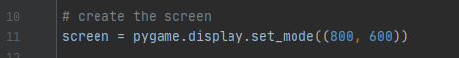
Background
This is the background which is added to the game. With the height of 800px and width of 600px.

Slide 10
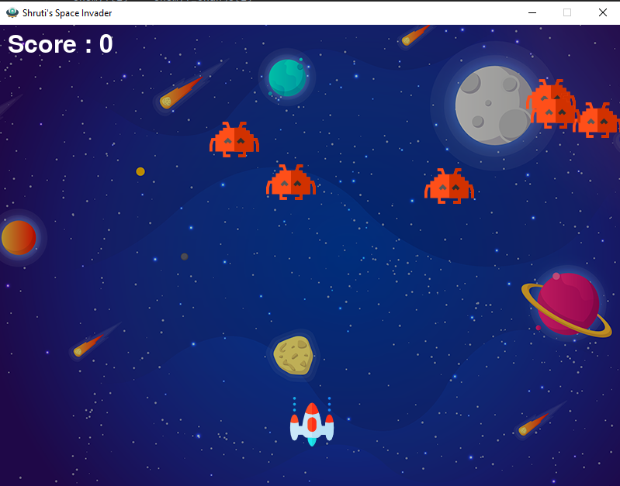
Final Output

Slide 11
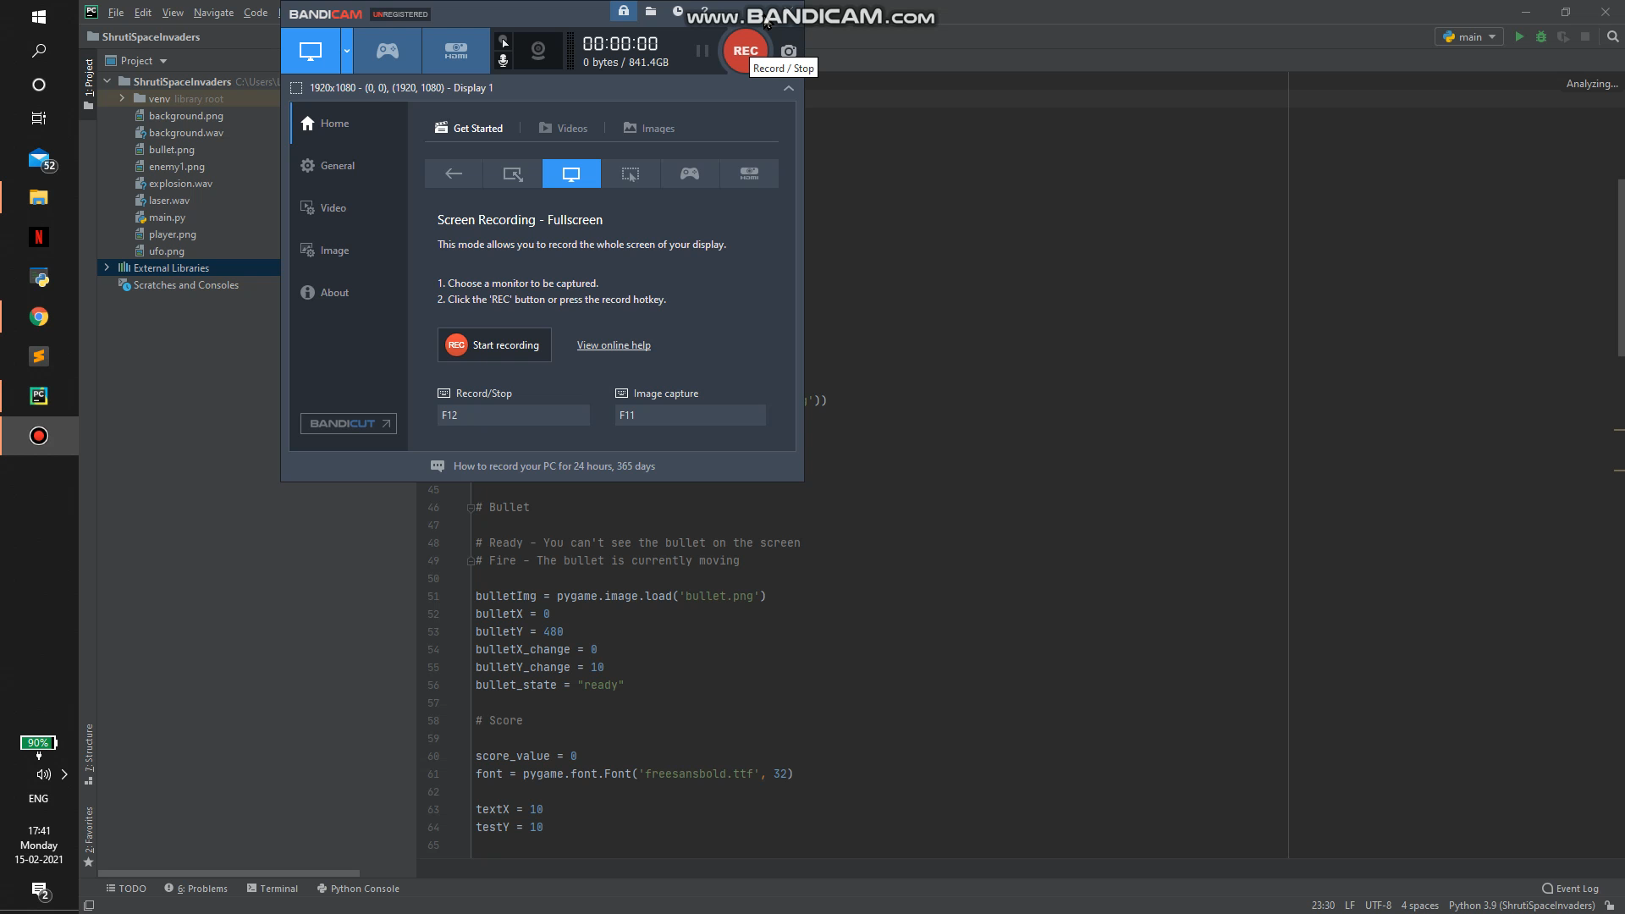
Demo

Slide 12
Thank You

